Slide 1

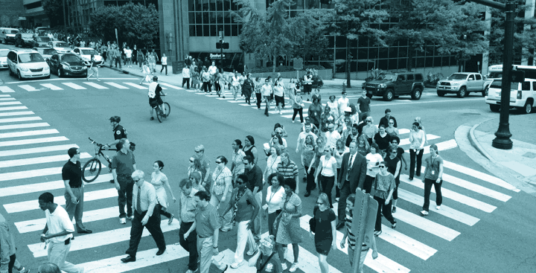

Nashville-Davidson County Strategic Plan For Sidewalks and Bikeways
The WalknBike plan will improve walking and biking in Nashville, connecting people to opportunity on a network of high-quality, comfortable, and safe sidewalks and bikeways.

Slide 2
Project Purpose
The purpose of the plan is to outline goals, priorities and policies regarding location of the countywide sidewalk and bikeways network and provide a method for prioritizing improvements to ensure a healthy, active, safe and vibrant community.

Slide 3




Project Team

Slide 4
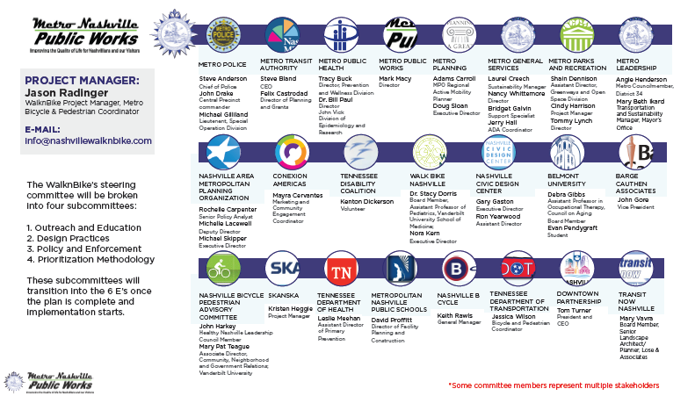
Steering Committee

Slide 5

Project Focus
"As Mayor I will continue to engage our bicycle and pedestrian advocates, non-profits like Walk-Bike Nashville, and our Metro departments to ensure we are implementing polices that will enable more people to safely take advantage of all modalities of transit." - Nashville Mayor Megan Barry
4 Key Principles:
Ethics, Responsibility, Safety and
Mechanism for Change

Slide 6
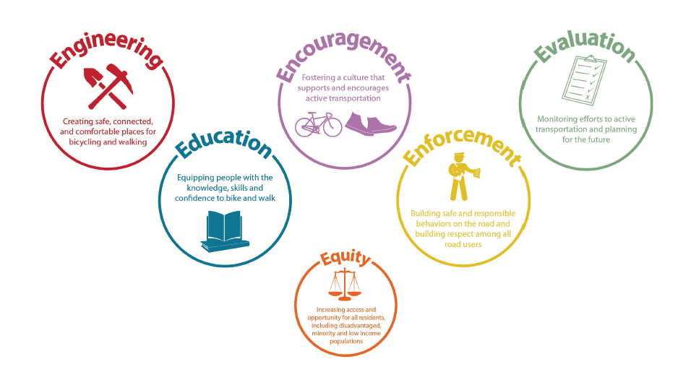
Project Focus

Slide 7
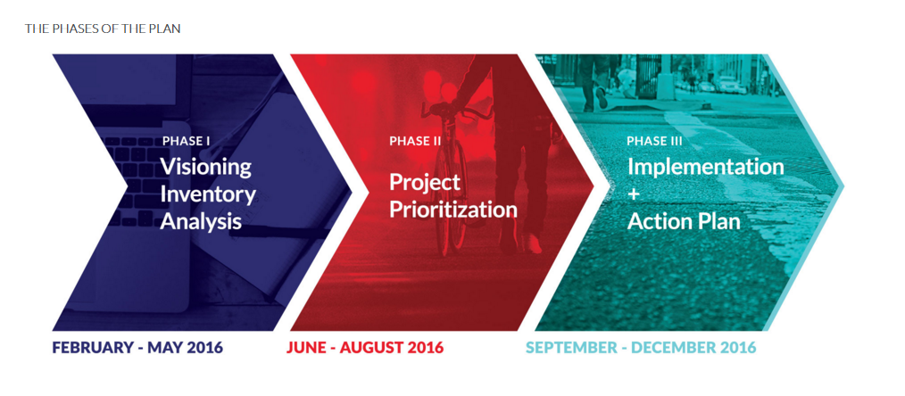
Project Schedule

Slide 8
Program History

Slide 9

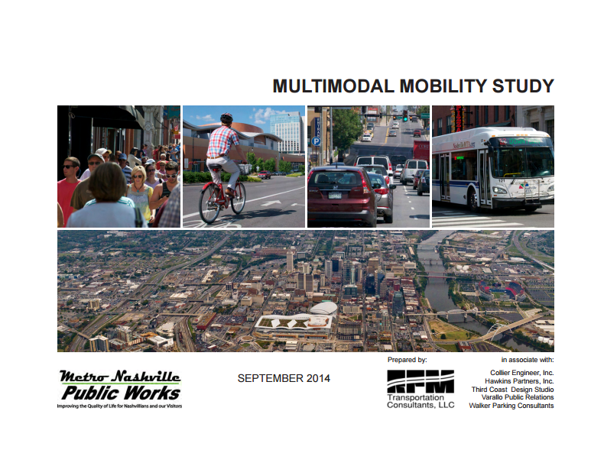
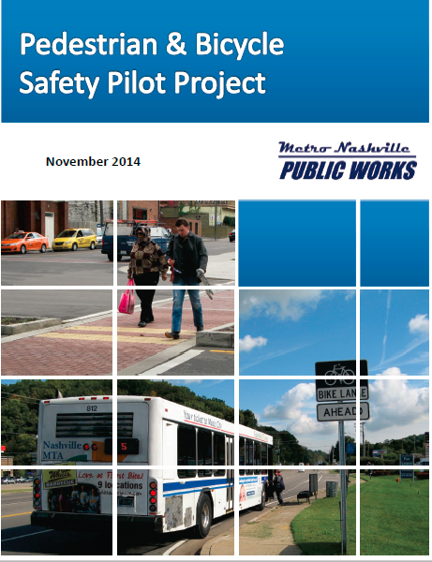
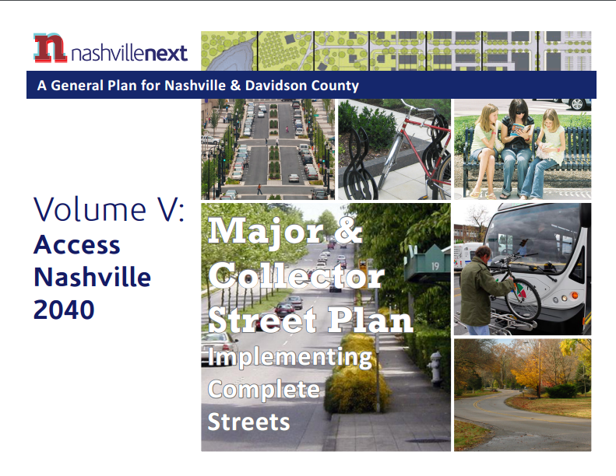
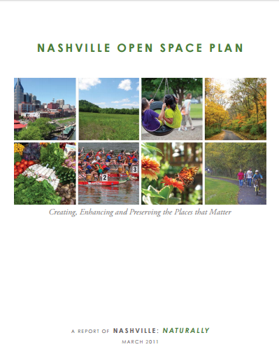
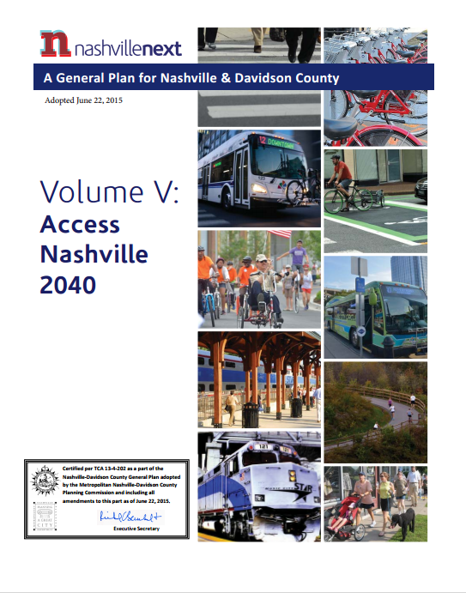
A Sampling of Previous Planning Efforts

Slide 10
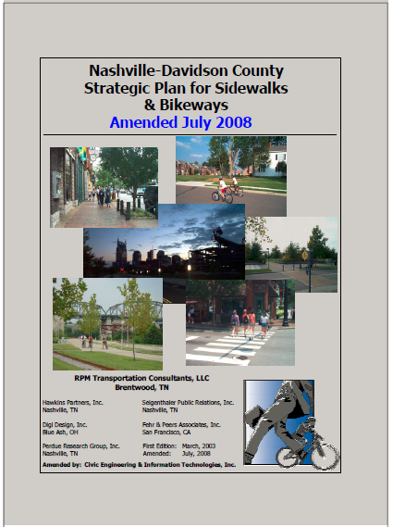
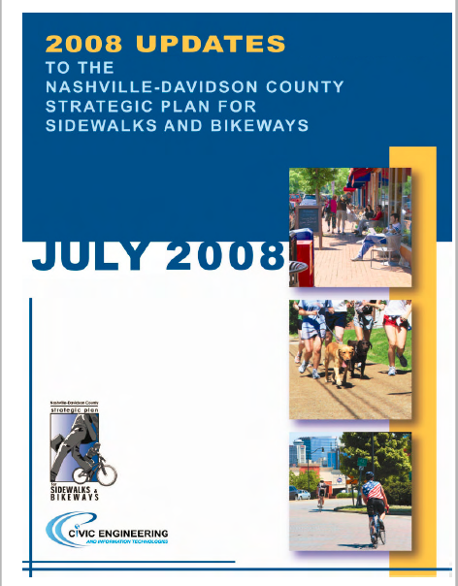

Program History
2003
2008
2016

Slide 11
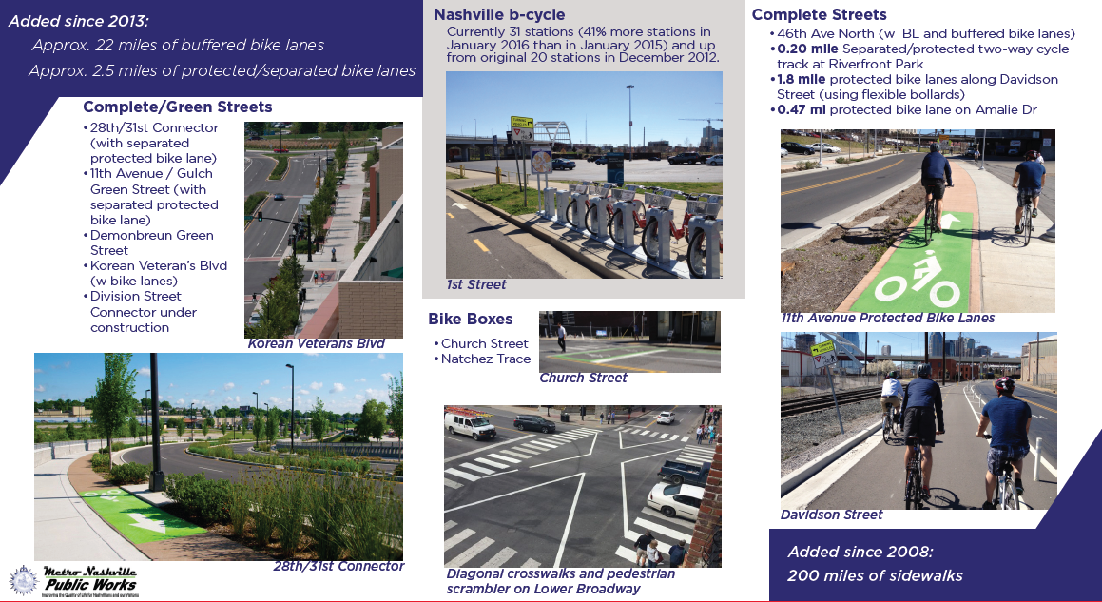
Program Accomplishments

Slide 12
Overview of Current Prioritization Methodology

Slide 13
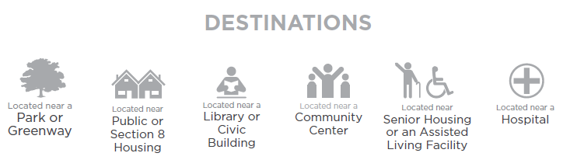
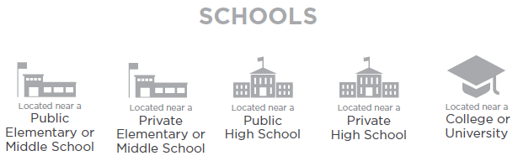
Existing Prioritization Factors

Slide 14
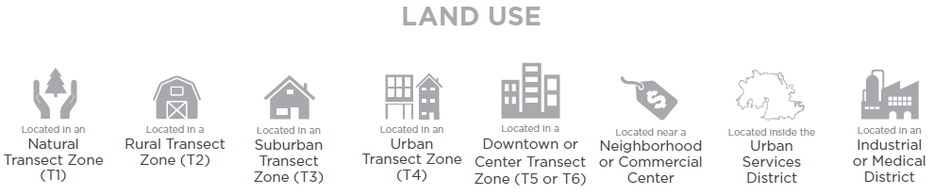
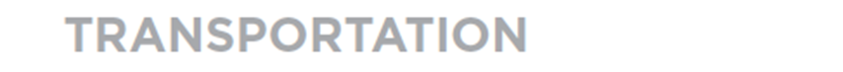
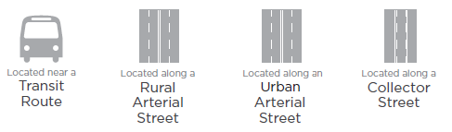
Existing Prioritization Factors

Slide 15
Public Outreach

Slide 16
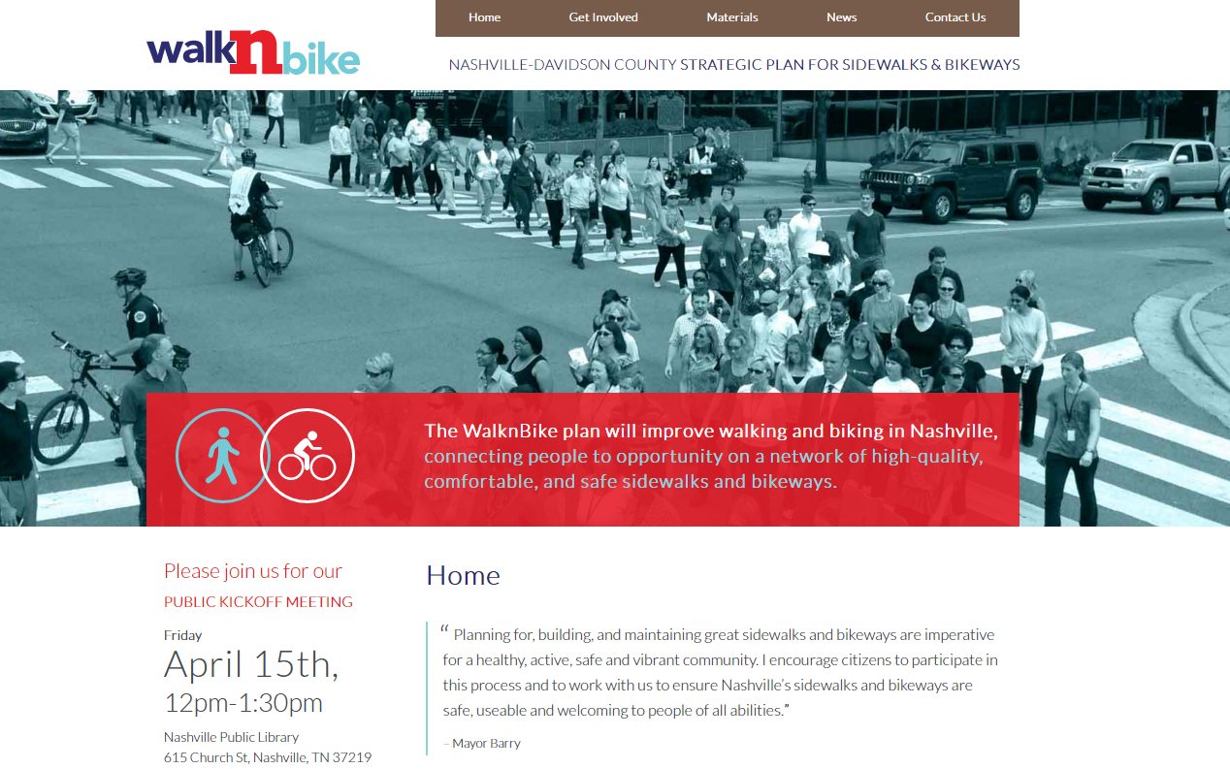
Stay Involved!
www.nashvillewalknbike.com

Slide 17
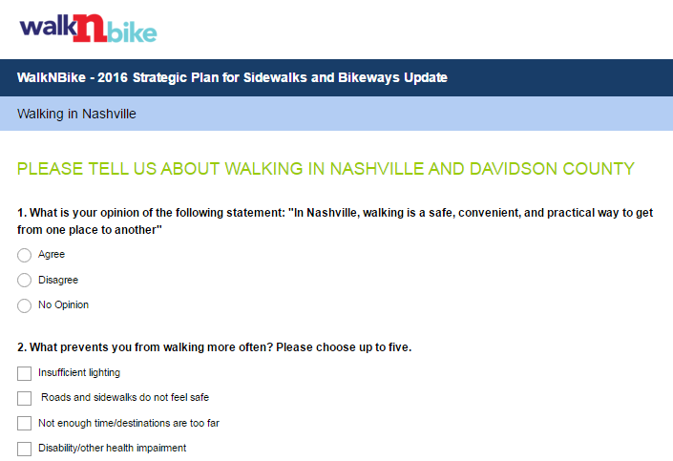
Take the Survey!
www.nashvillewalknbike.com
1,535 Surveys Complete to Date
500 Email Contacts

Slide 18
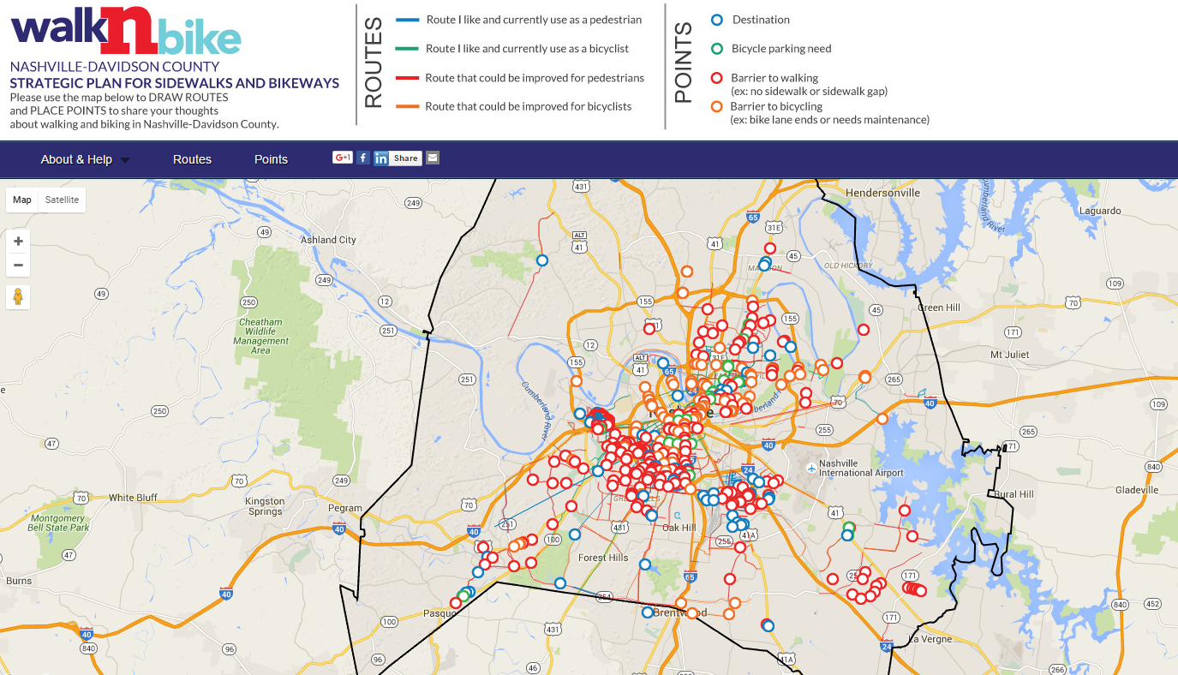
Draw on the Map!
www.nashvillewalknbike.com

Slide 19

Request a “WalknBike Talk”!
Help us identify groups to talk to and events to attend!
Contact us at Info@nashvillewalknbike.com

Slide 20
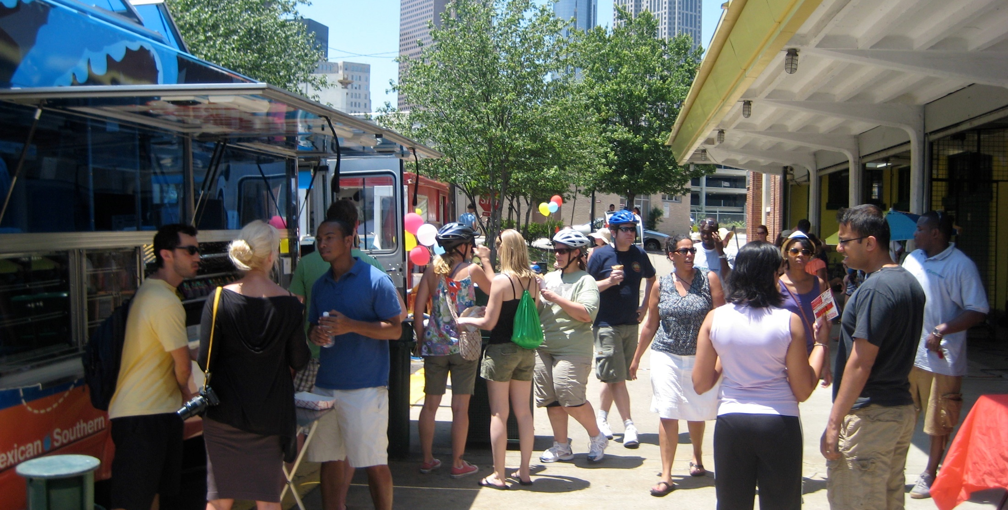
Community Outreach Strategy
Outreach Tools
Community Meetings
Community Events
Project Website
Community Survey
Interactive Map
Handlebar and Sidewalk Surveys
Social Media
Traditional Media
Kickoff Meeting
Prioritization Meetings
Open House
Tour de Nash
Open Streets Nashville

Slide 21
What We’ve Heard So Far

Slide 22
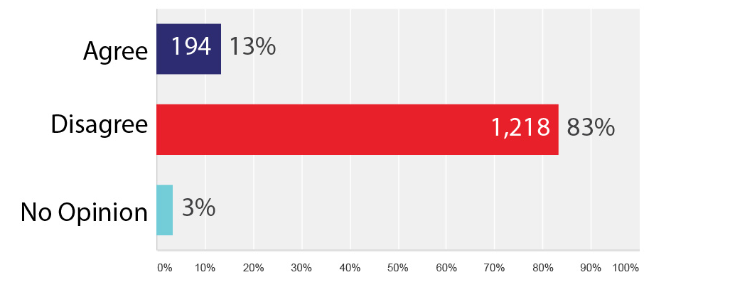
“In Nashville, walking is a safe, convenient, and practical way to get from one place to another”

Slide 23
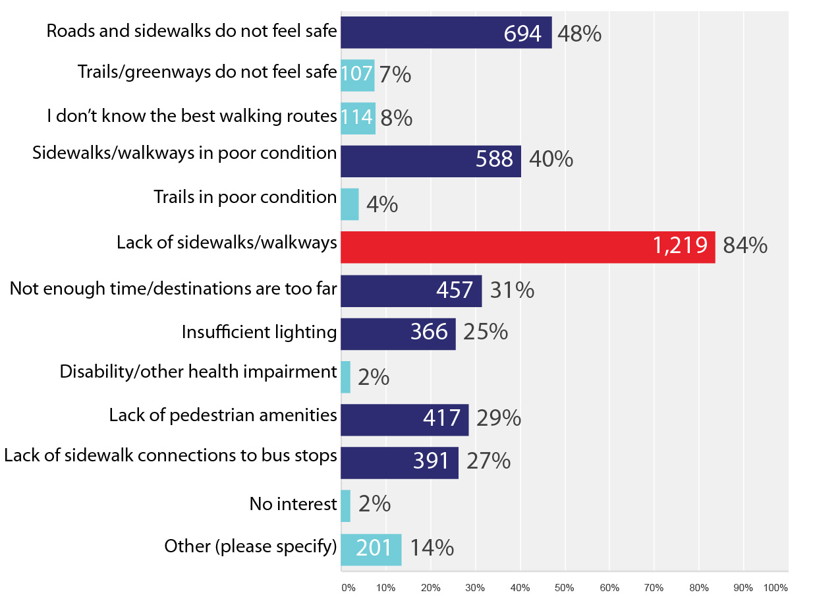
What prevents you from walking more often?

Slide 24
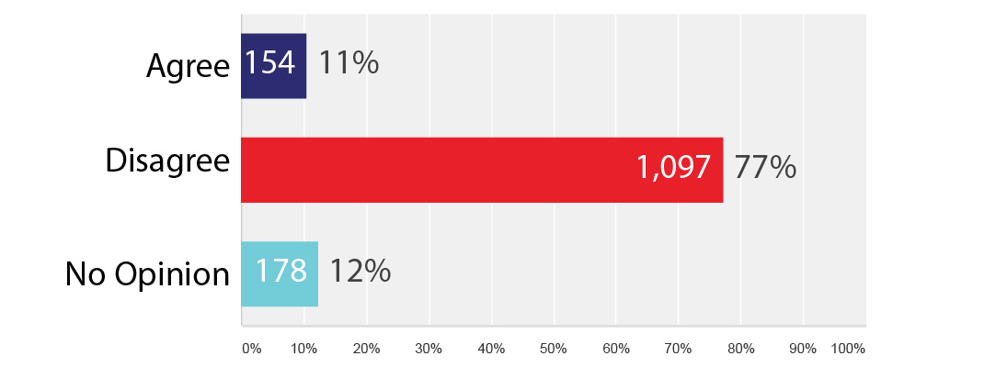
“In Nashville, biking is a safe, convenient, and practical way to get from one place to another”

Slide 25
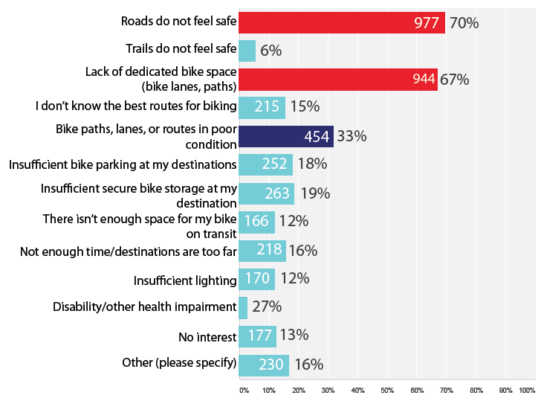
What prevents you from biking more often?

Slide 26
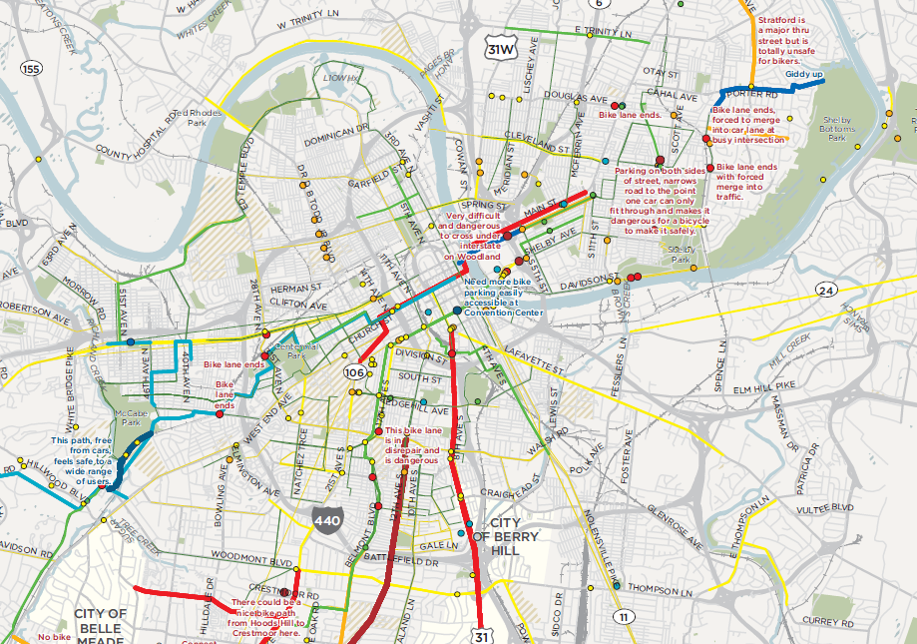
Interactive Map Comments To-Date
702 Points
1,231 Routes/Lines

Slide 27
Public Kickoff Meeting Input Stations

Slide 28
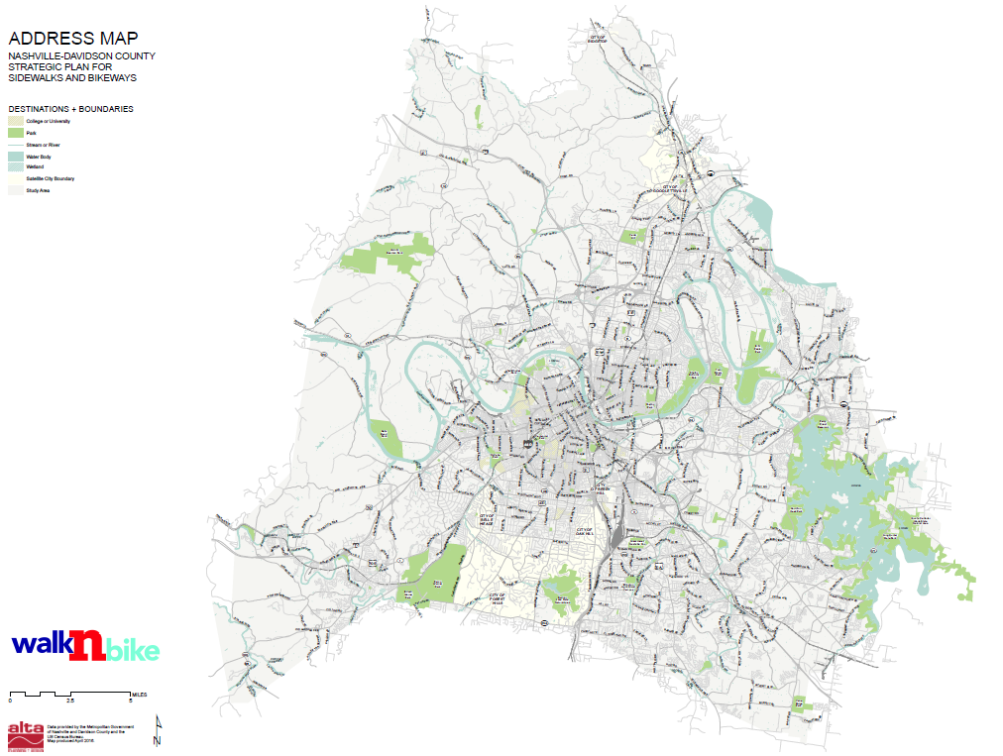
Station #1: Sign-In and Address Map

Slide 29
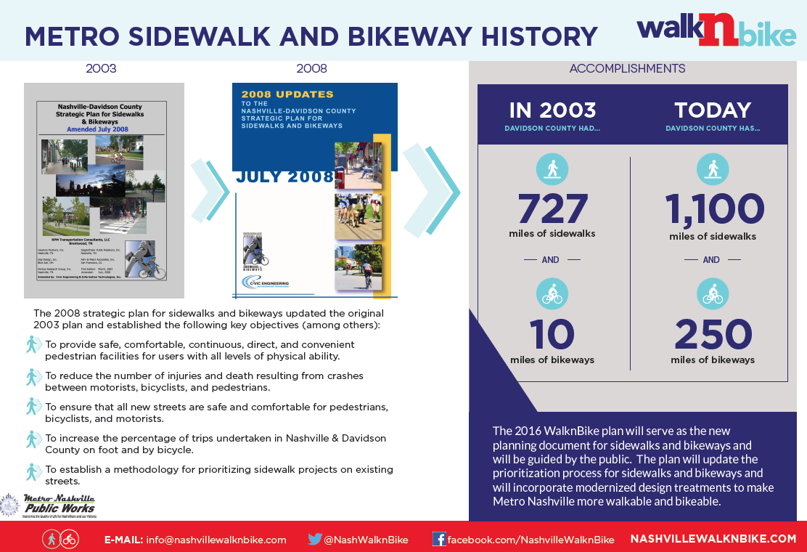
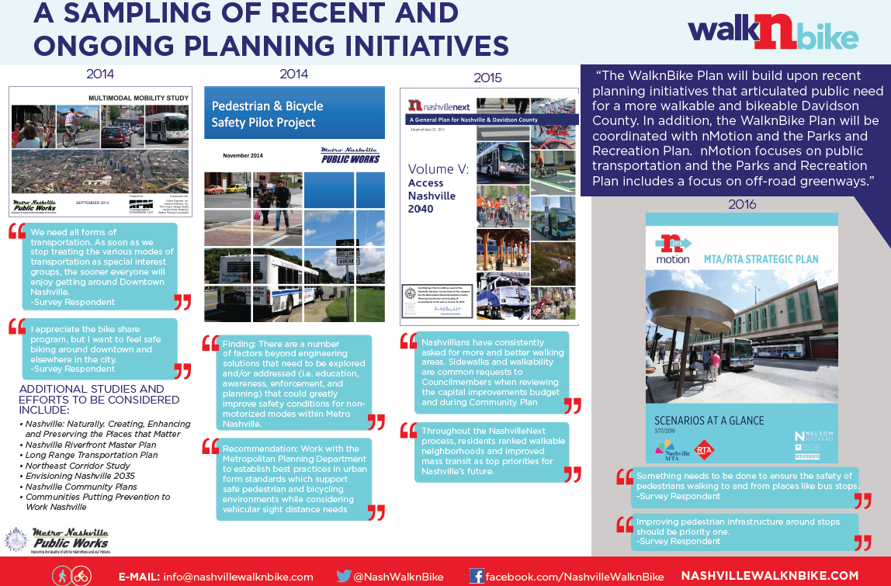
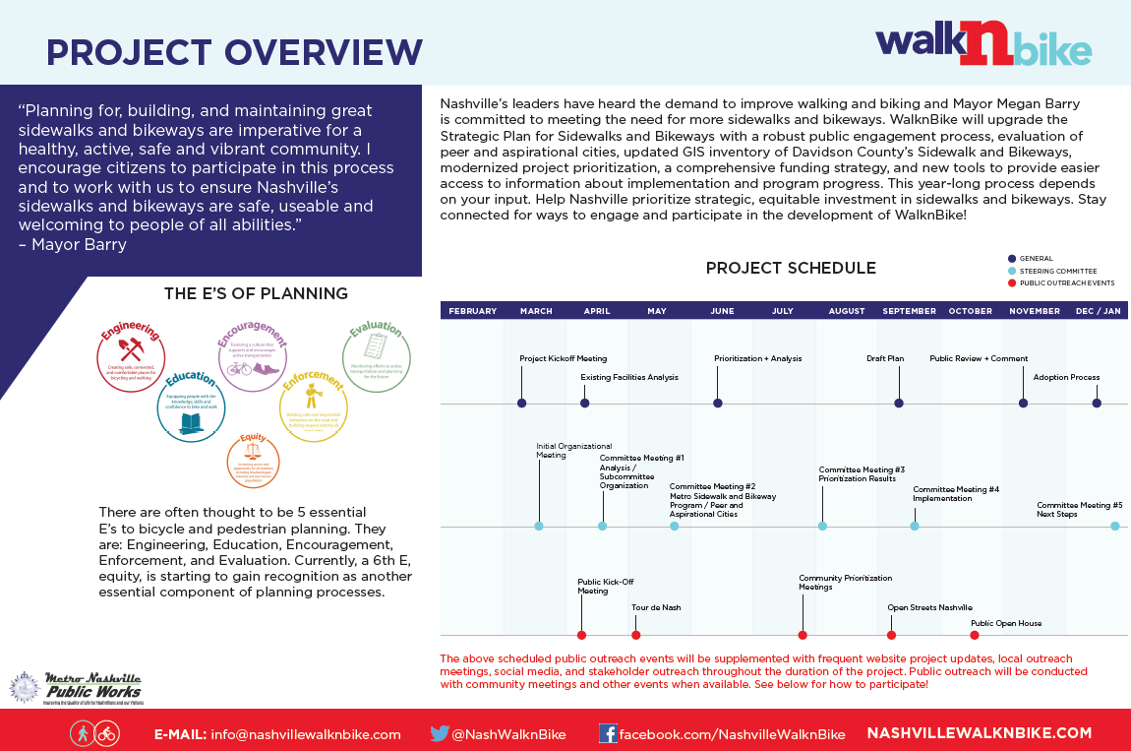
Station #2: Project Overview, Previous Planning Efforts, & Program Accomplishments

Slide 30
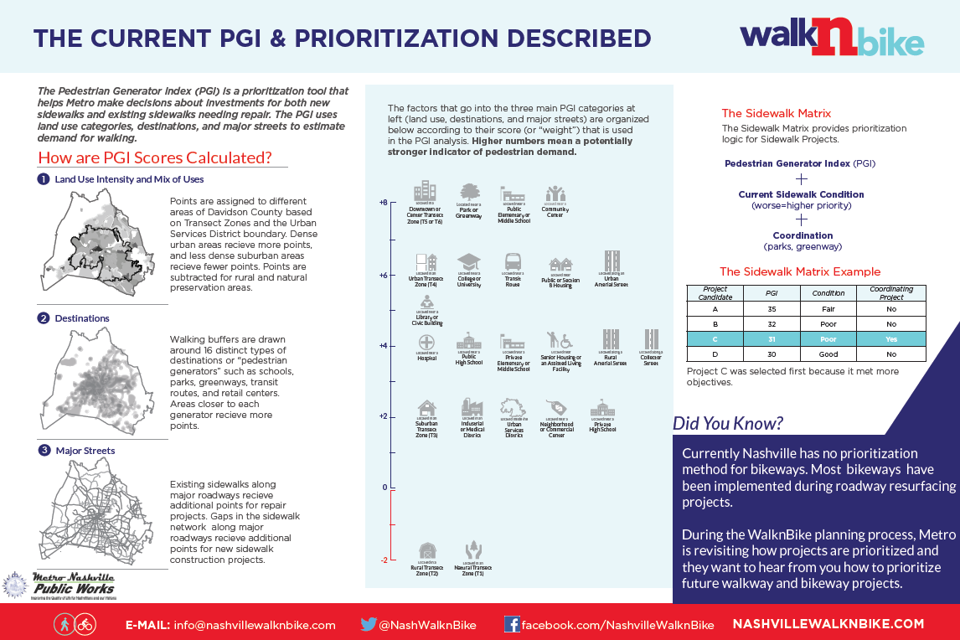
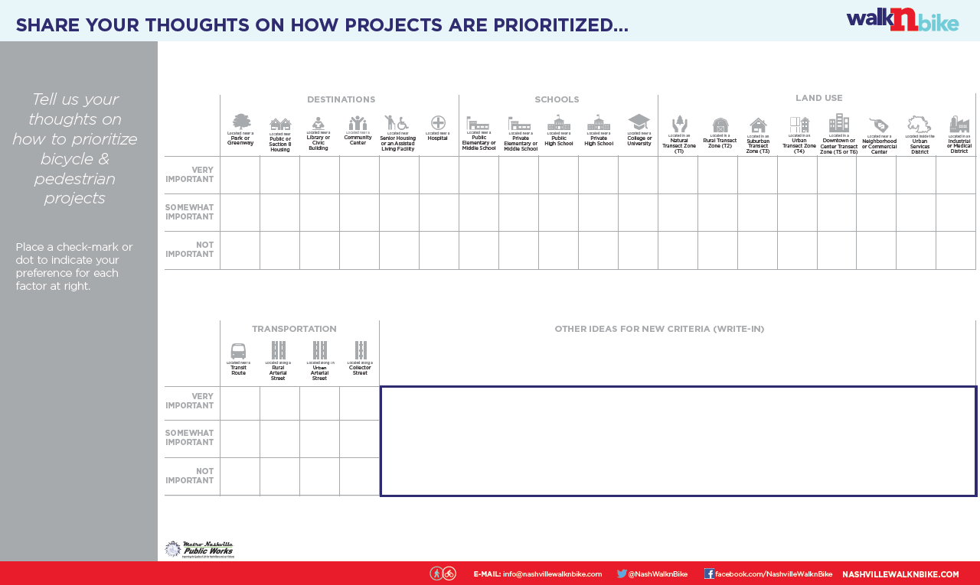
Station #3: Prioritization Overview and Input Opportunity

Slide 31
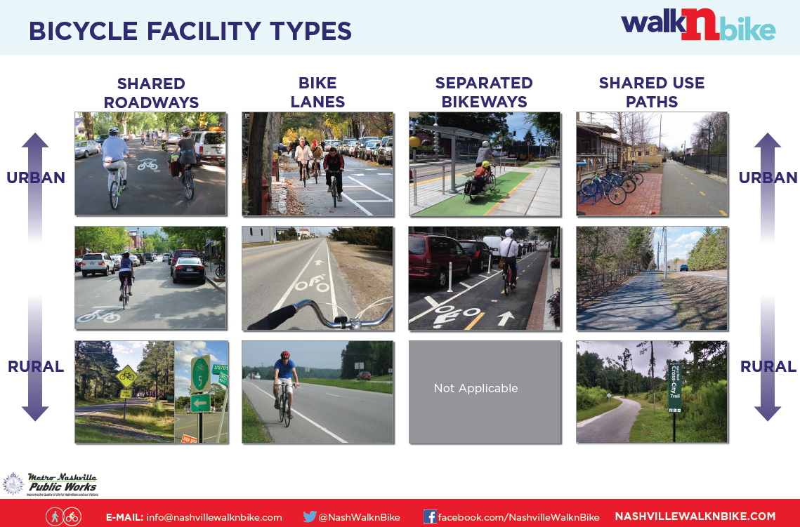
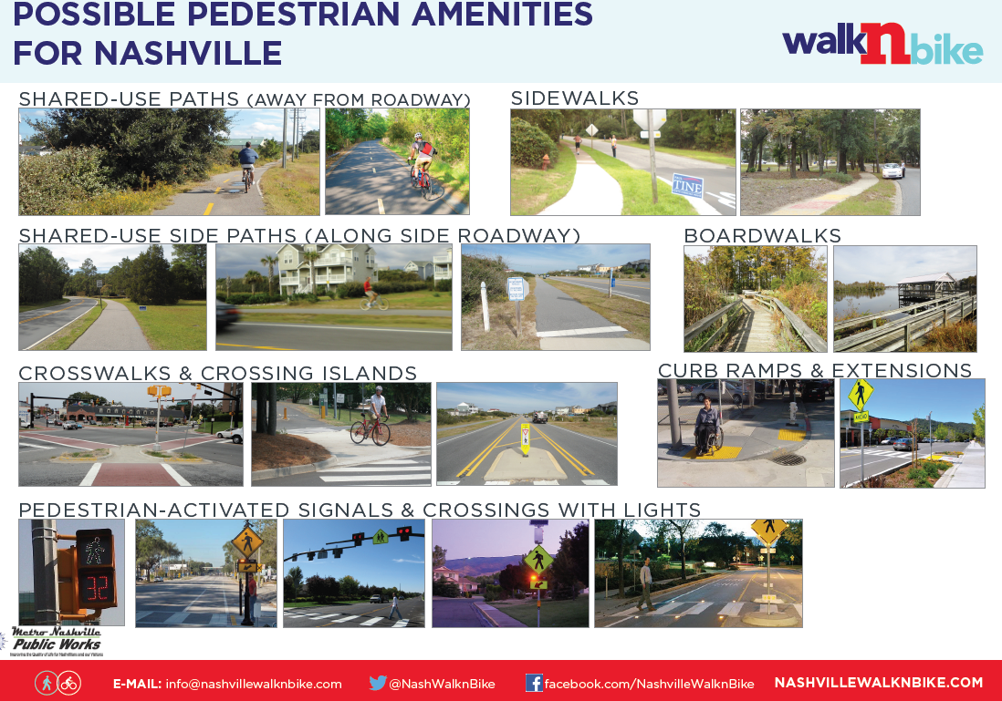
Station #3: Visual Preference Survey

Slide 32
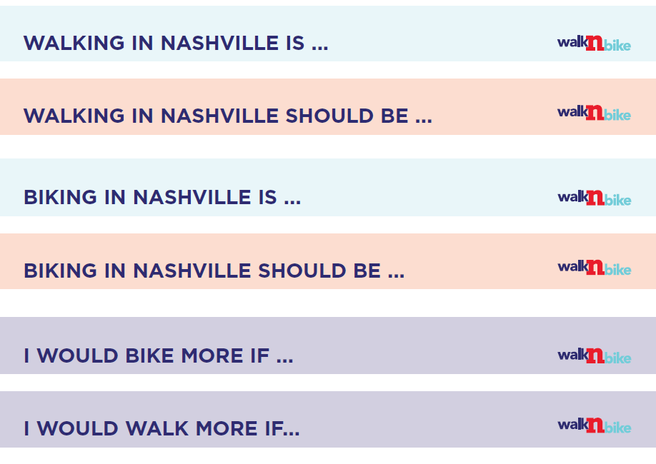
Station #4: Public Statements

Slide 33
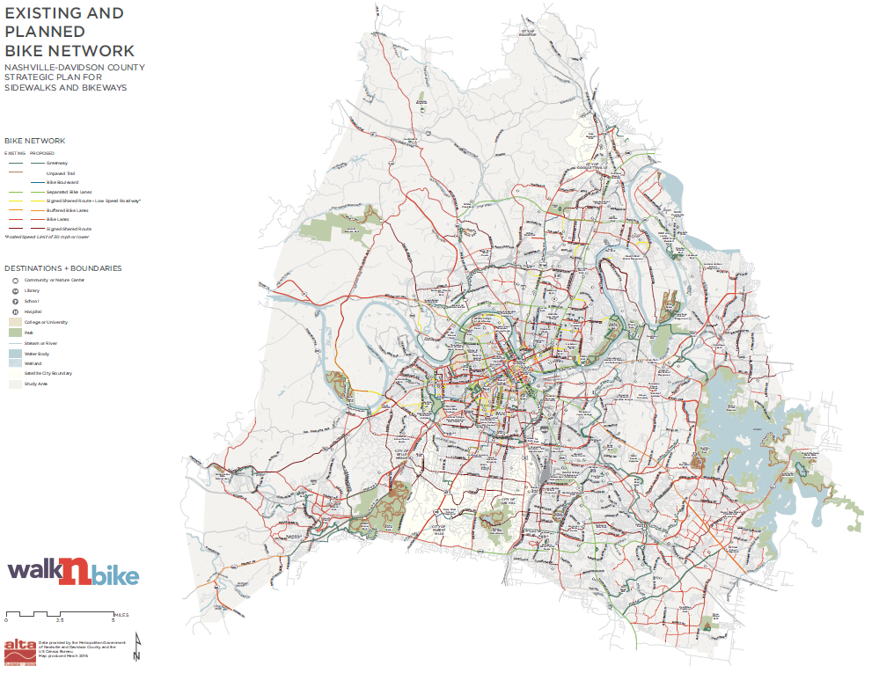
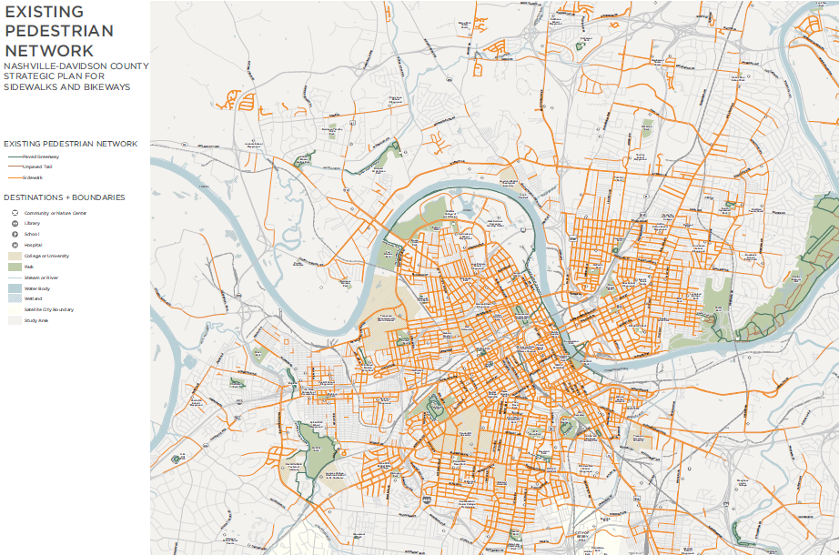
Station #5: Map Exercise

Slide 34
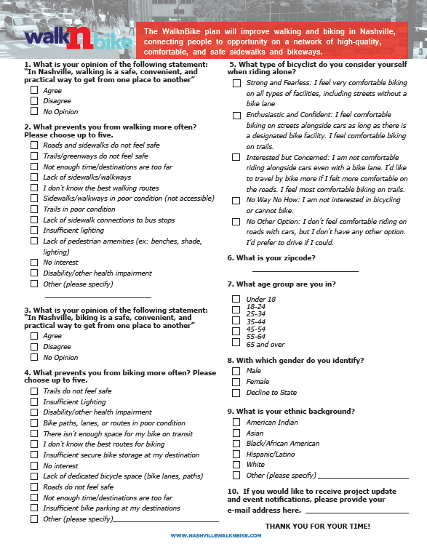
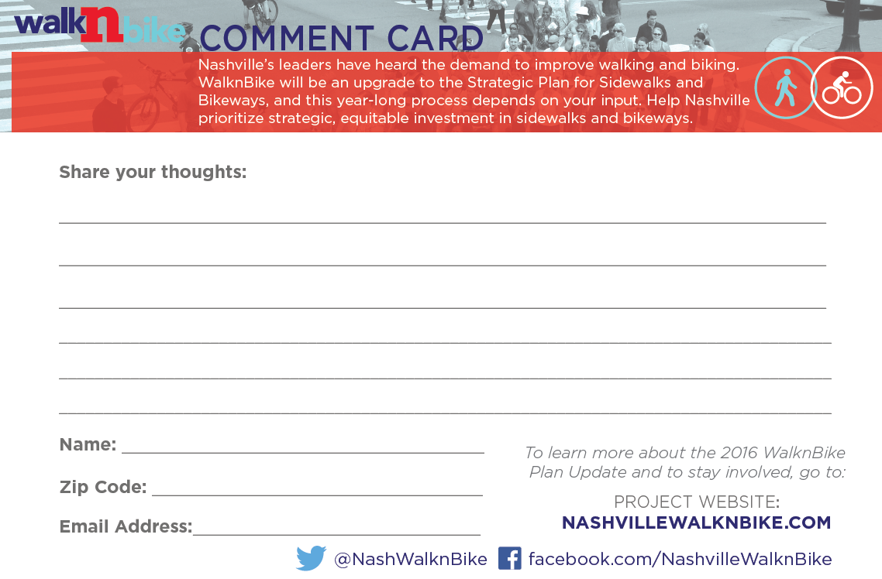
Station #6: User Survey & Comment Forms

Slide 35
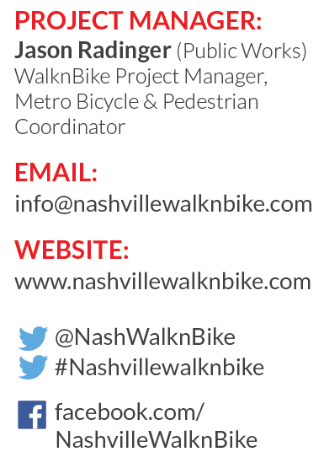
Contact Us!

