Slide 1

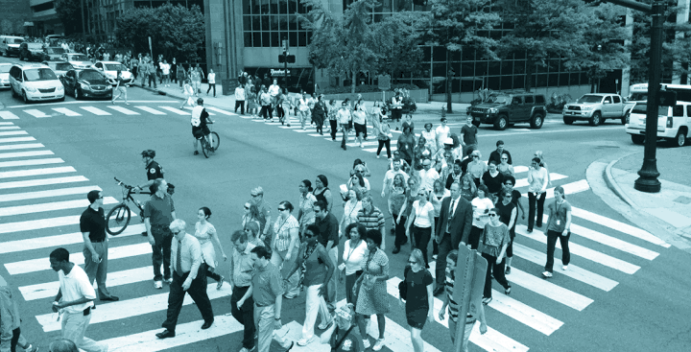

Nashville-Davidson County Strategic Plan For Sidewalks and Bikeways
The WalknBike plan will improve walking and biking in Nashville, connecting people to opportunity on a network of high-quality, comfortable, and safe sidewalks and bikeways.

Slide 2
“Planning for, building, and maintaining great sidewalks
and bikeways are imperative for a healthy, active, safe and vibrant community. I encourage citizens to participate in this process and to work with us to ensure Nashville’s sidewalks and bikeways are safe, useable and welcoming to people of all abilities.”
Mayor Megan Barry

Slide 3
“With Mayor Barry’s leadership, we are confident that the new plan will provide the framework to ensure that pedestrians and bicyclists remain a top priority in transportation planning. I look forward to working alongside the public, getting their input on needs and priorities, and putting those ideas to use."
Mark Macy, Public Works Director

Slide 4
Project Purpose
The purpose of the plan is to outline goals, priorities
and policies regarding location of the countywide sidewalk and bikeways network and provide a method for prioritizing improvements to ensure a healthy, active,
safe and vibrant community.

Slide 5




Project Team

Slide 6
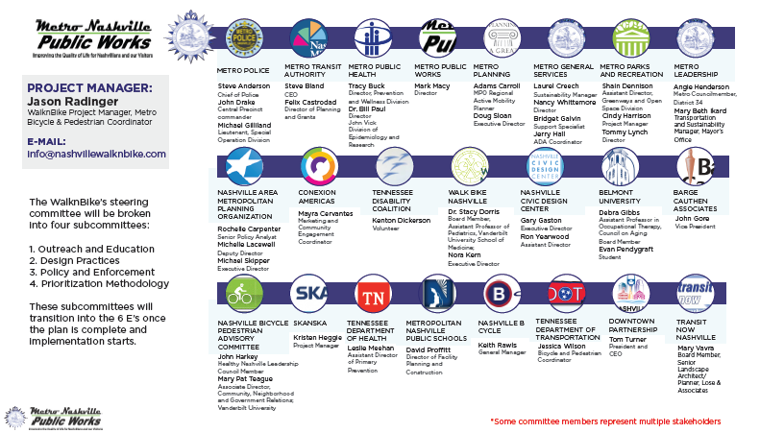
Steering Committee

Slide 7

Project Focus
"As Mayor I will continue to engage our bicycle and pedestrian advocates, non-profits like Walk-Bike Nashville, and our Metro departments to ensure we are implementing polices that will enable more people to safely take advantage of all modalities of transit." - Nashville Mayor Megan Barry
4 Key Principles:
Ethics, Responsibility, Safety and
Mechanism for Change

Slide 8
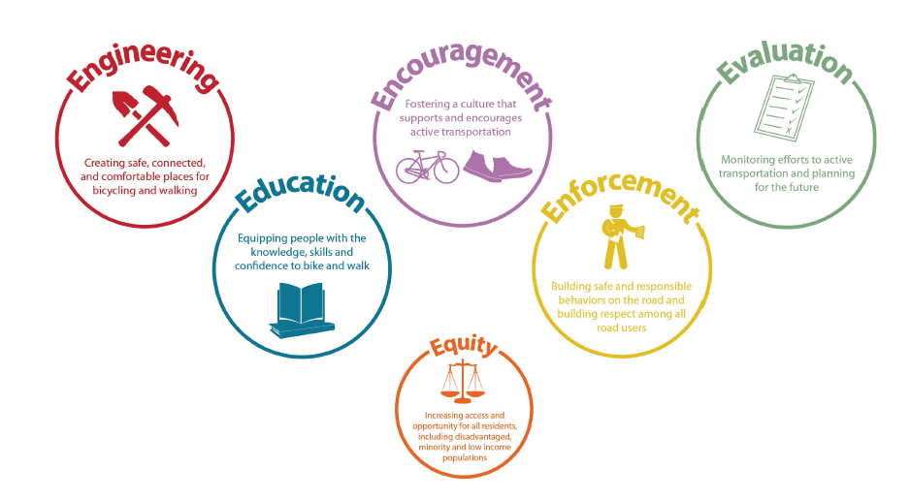
Project Focus

Slide 9
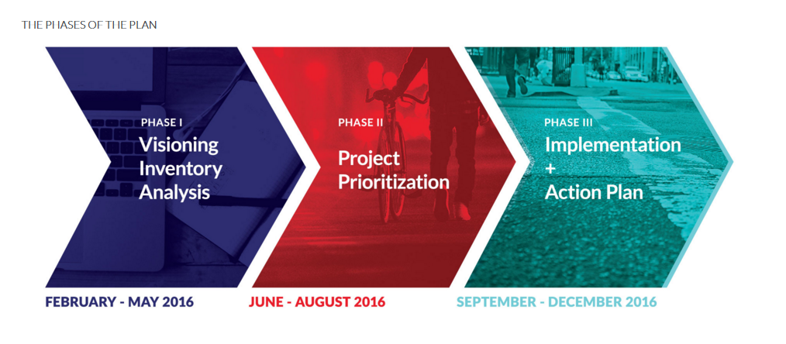
Project Schedule

Slide 10

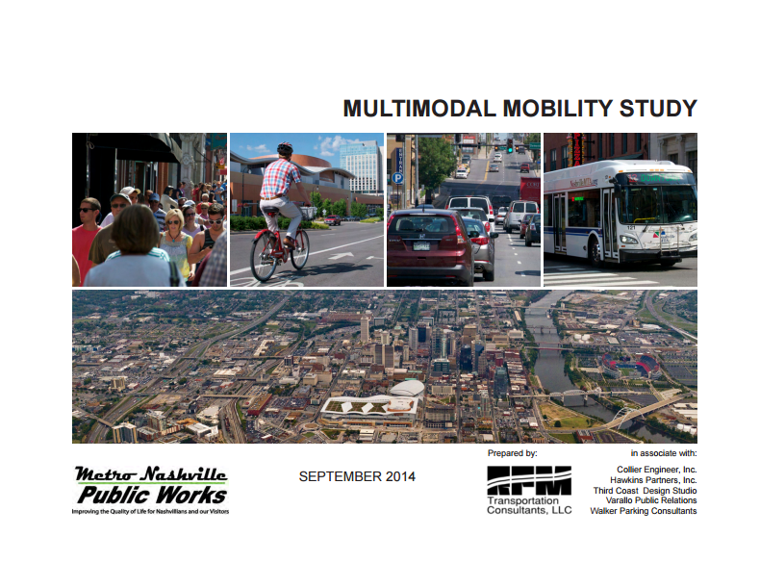
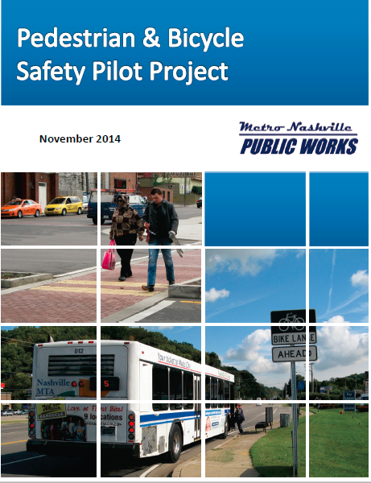
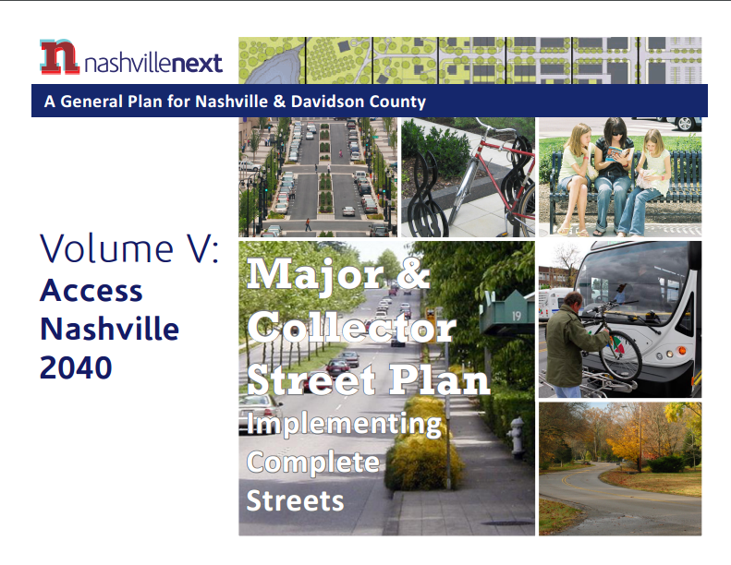
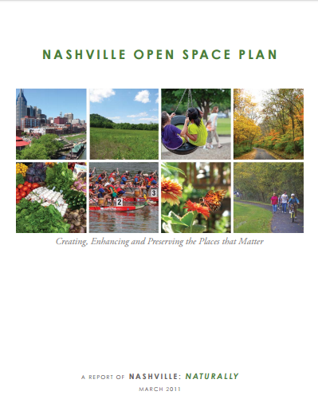

A Sampling of Previous Planning Efforts

Slide 11
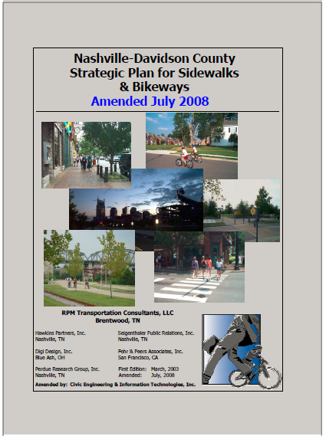
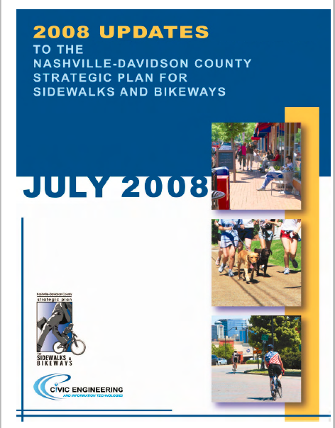

Program History
2003
2008
2016

Slide 12
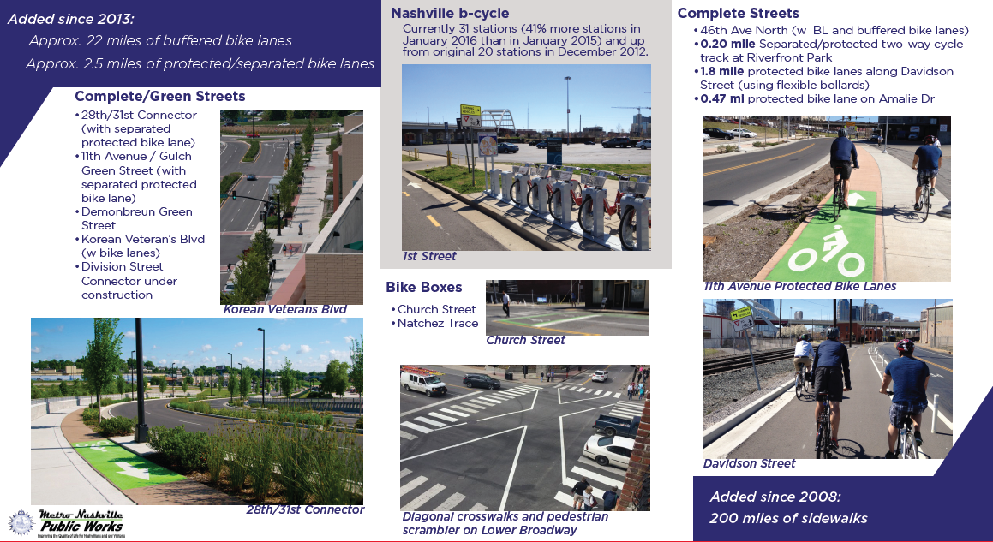
Program Accomplishments

Slide 13
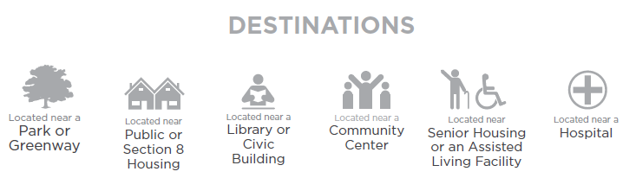
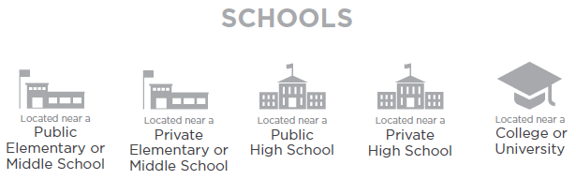
Current Prioritization Factors

Slide 14
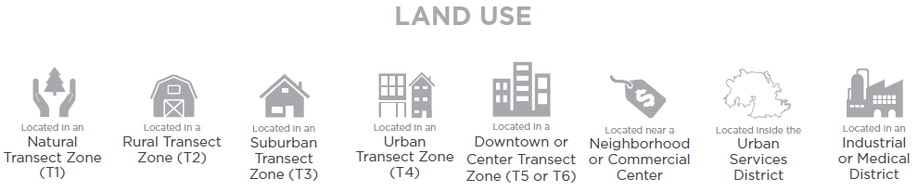
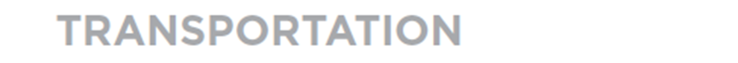
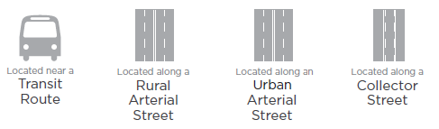
Current Prioritization Factors

Slide 15
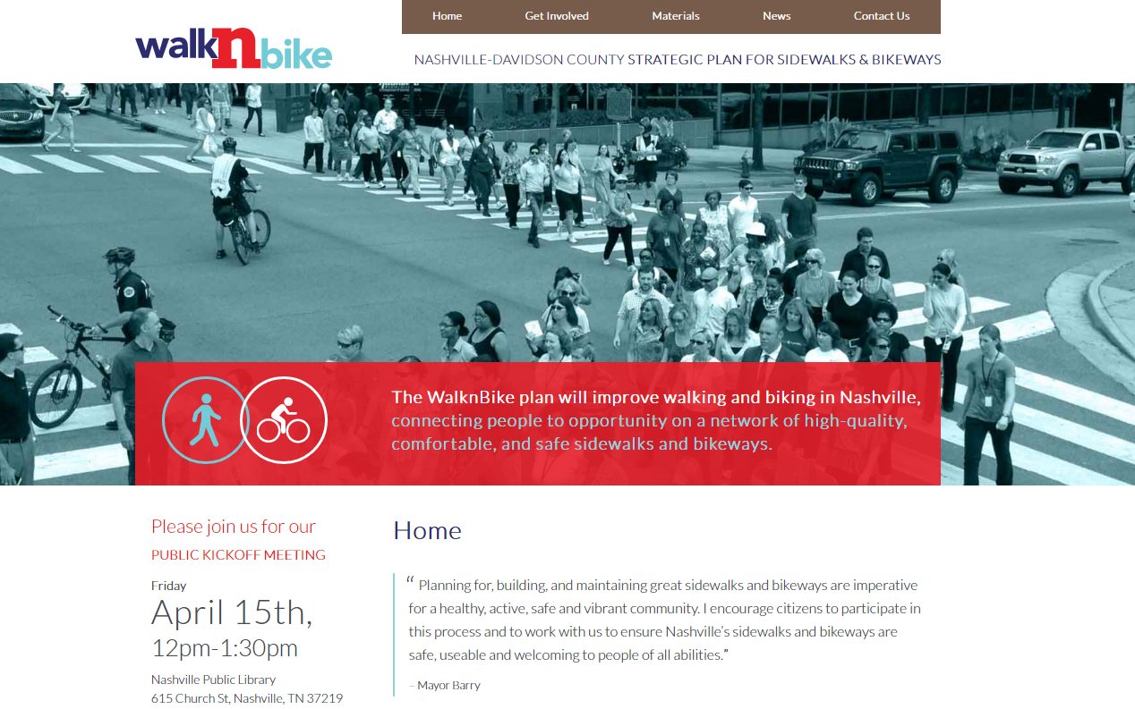
Stay Involved!
www.nashvillewalknbike.com

Slide 16
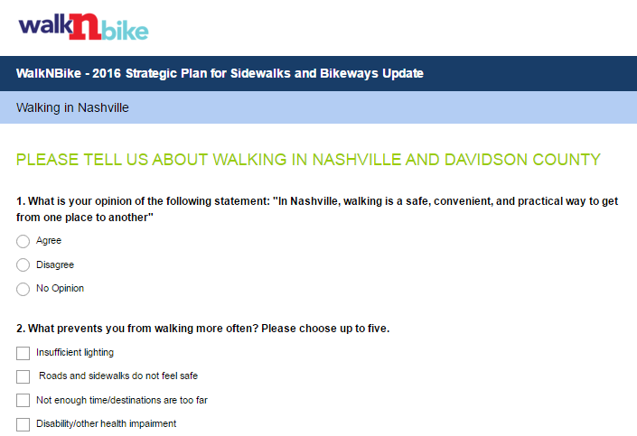
Take the Survey!
www.nashvillewalknbike.com

Slide 17
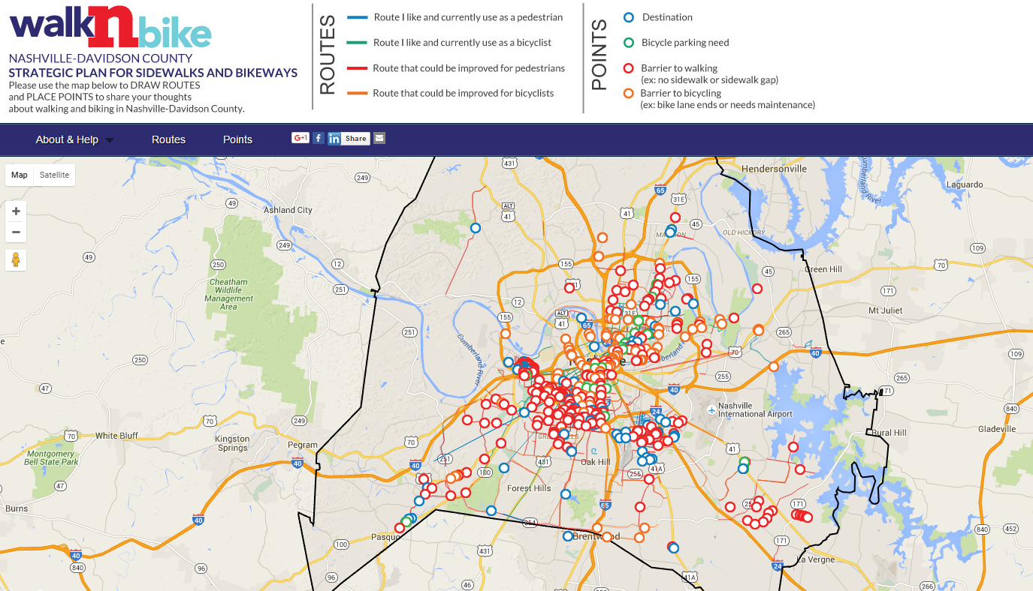
Draw on the Map!
www.nashvillewalknbike.com

Slide 18

Request a “WalknBike Talk”!
Help us identify groups to talk to and events to attend!
Contact us at Info@nashvillewalknbike.com

Slide 19
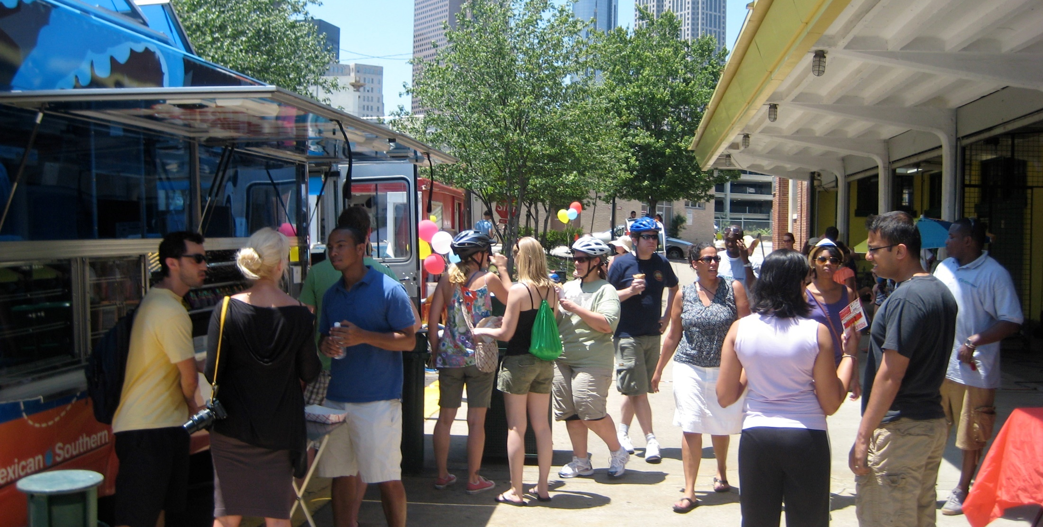
Community Outreach Strategy
Outreach Tools
Community Meetings
Community Events
Project Website
Community Survey
Interactive Map
Handlebar and Sidewalk Surveys
Social Media
Traditional Media
Kickoff Meeting
Prioritization Meetings
Open House
Tour de Nash
Open Streets Nashville

Slide 20
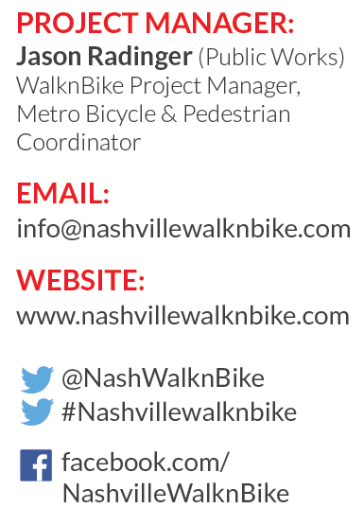
Contact Us!

